Slide 1


4.4 Brand Yourself Presentation: Final Submission
By
Edward Welborn

Slide 2
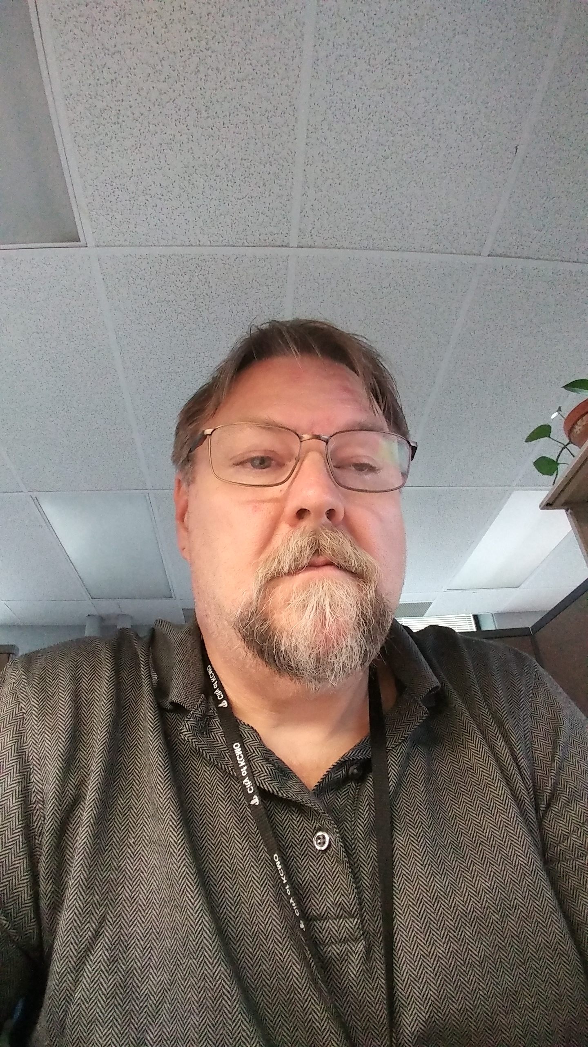
This is ME
Passionate about the work I do
Driven to keep cost and project time low
Full Sail Graduate with a Bachelors in Mobile Development
Computer Geek
Fanatical Computer Gamer
Future Mobile Design professional
Old school job ethics with new ways of thinking

Slide 3
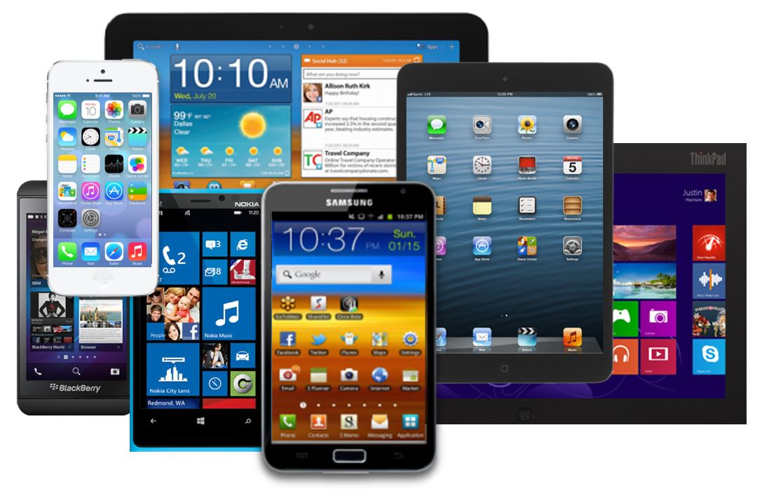
What Matters
Millions of mobile devices are being used today
Many million more will be sold in the next few years
Connect.com states in their August 24, 2015 report,
A report by a US market research company suggests that there are now more mobile devices on the planet than people – 8.6 billion devices vs. 7.3 billion people.
With an estimated 5.8 billion mobile users worldwide, that means almost 80% of the planet’s population are mobile, and they have an average of 1.5 devices each.

Slide 4
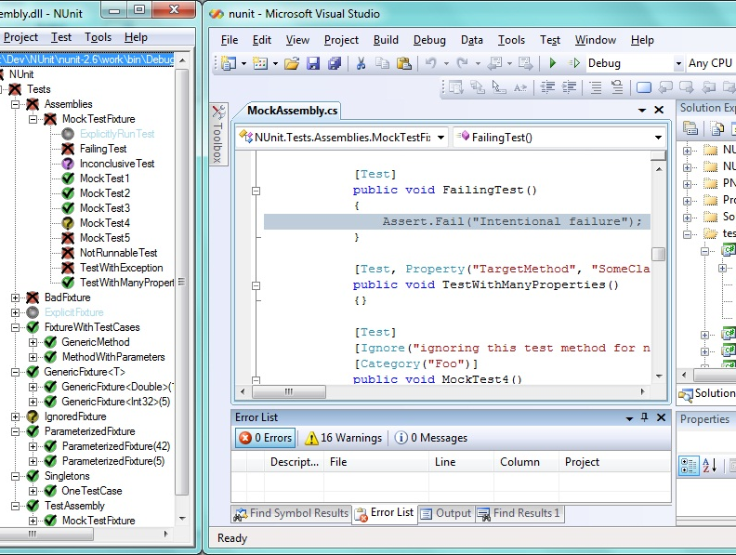
What I bring to the table
Knowledge of mobile design and development
30 years of experience in development, support, quality assurance and administration
Hard working, opened minded thinking
Creative and user friendly mindset with developing new user interfaces
Proven cost reducing project management

Slide 5
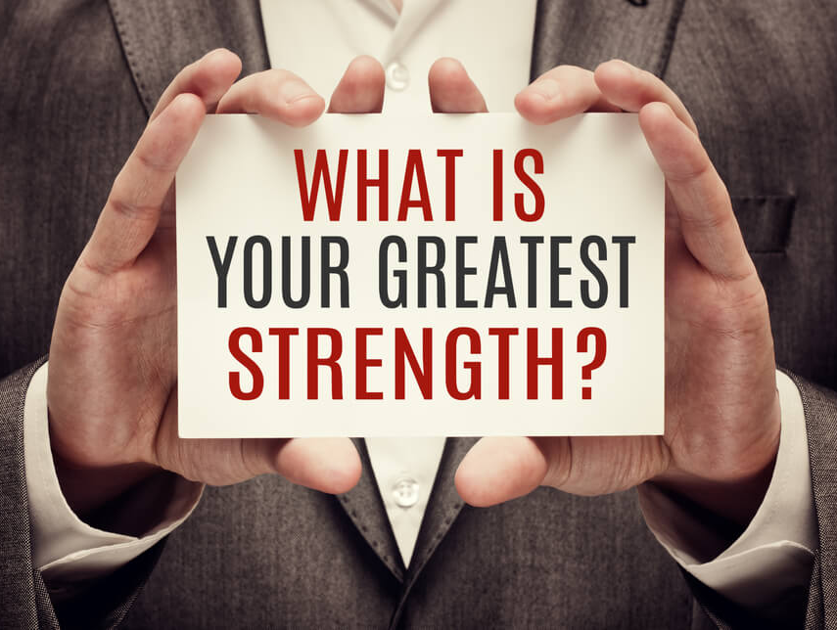
What are my greatest Strengths
Can relate to end users, and can speak the lingo without going into geekspeak
I love to jump headlong into projects, and excel at working and finishing projects in a timely manner while conserving cost.
I work well with others, as well as can work alone if the need arises.
I am reliable, honest, with a strong sense of leadership, and hard working
Very Laid back and easy going, I can handle stress very well.

Slide 6
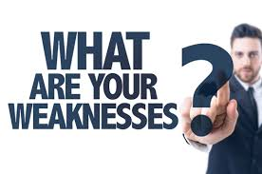
What are my greatest weakneses
I would have to say my greatest weakness has been a lack of proper planning in the past. I would over-commit myself to a number of very lengthy in depth projects, and not able to accomplish the task as I would like.
However, I have resolved that mindset, and now use a versatile project planning software in order to track my timeline, and complete each task, under budget, and earlier than the deadline states.

Slide 7
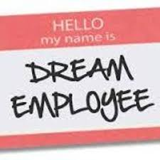
why hire me
I have a proven track record of brining projects in, on time, and under budget, which saves the company it’s hard earned cash flow
I have a talent for gathering project resources, by being able to plainly speak to the project coordinator, as well as the end users.
My varied background makes it easier to see the development phase from all sides, which makes the project flow better, easier, and much faster.

Slide 8


All picture acquired via royalty free, open source websites

